Slide 1

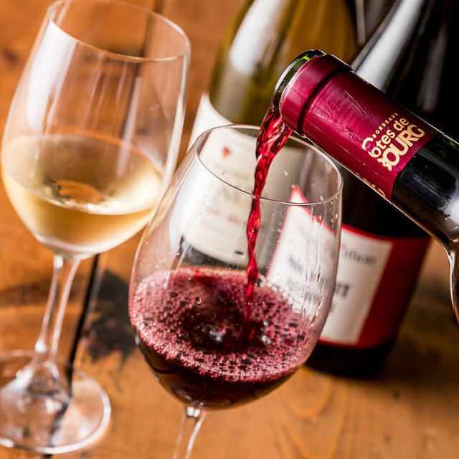
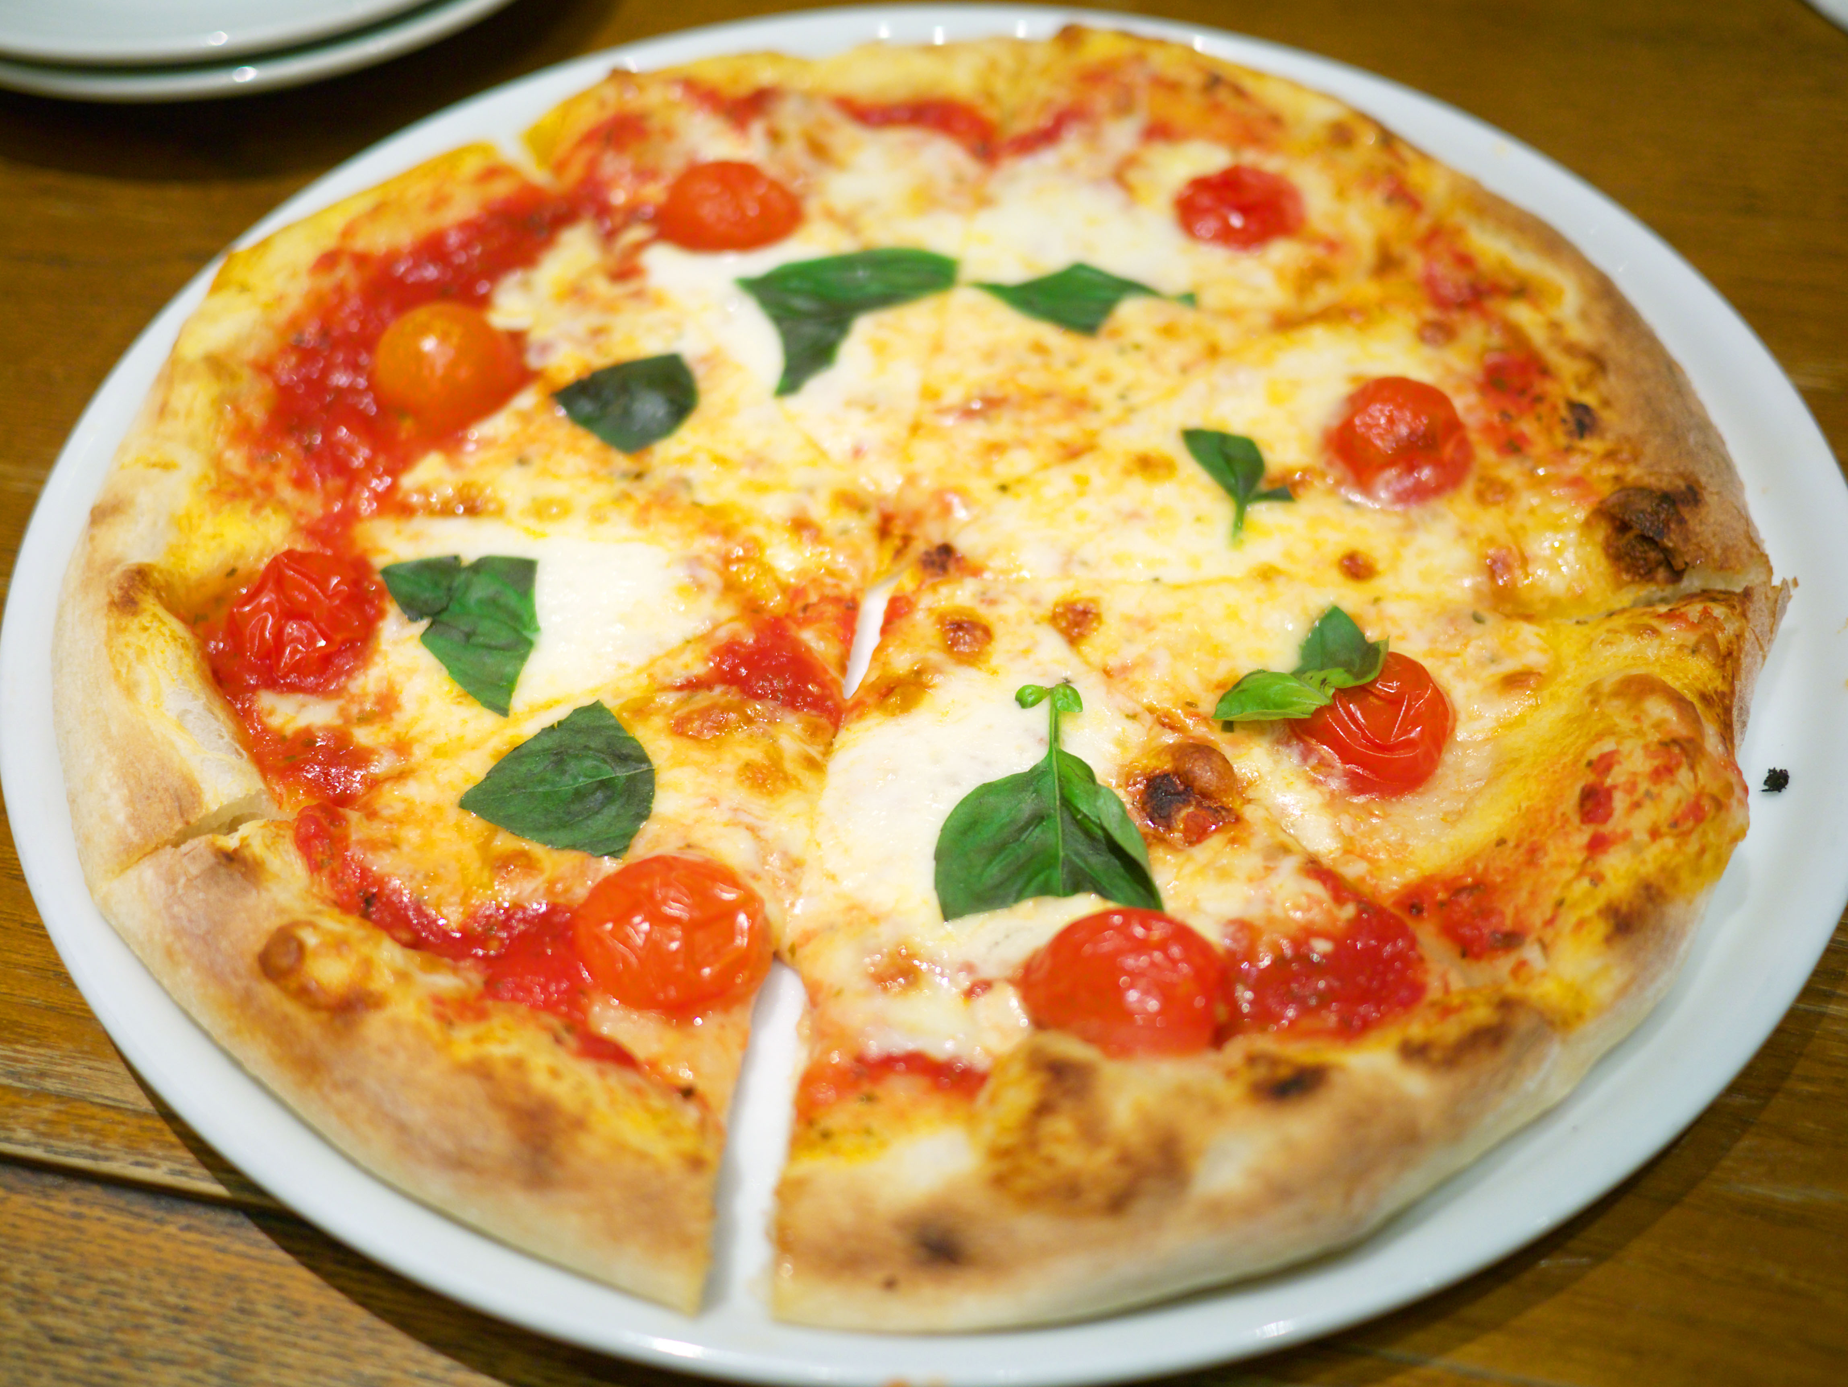
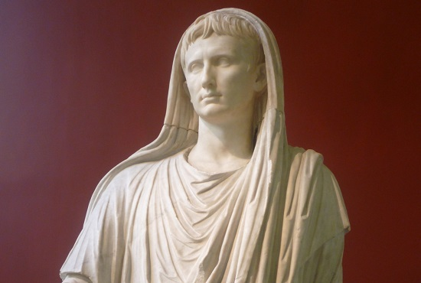
Italy
Mizuho
Yuko

Slide 2

What image do you have about Italy?

Slide 3
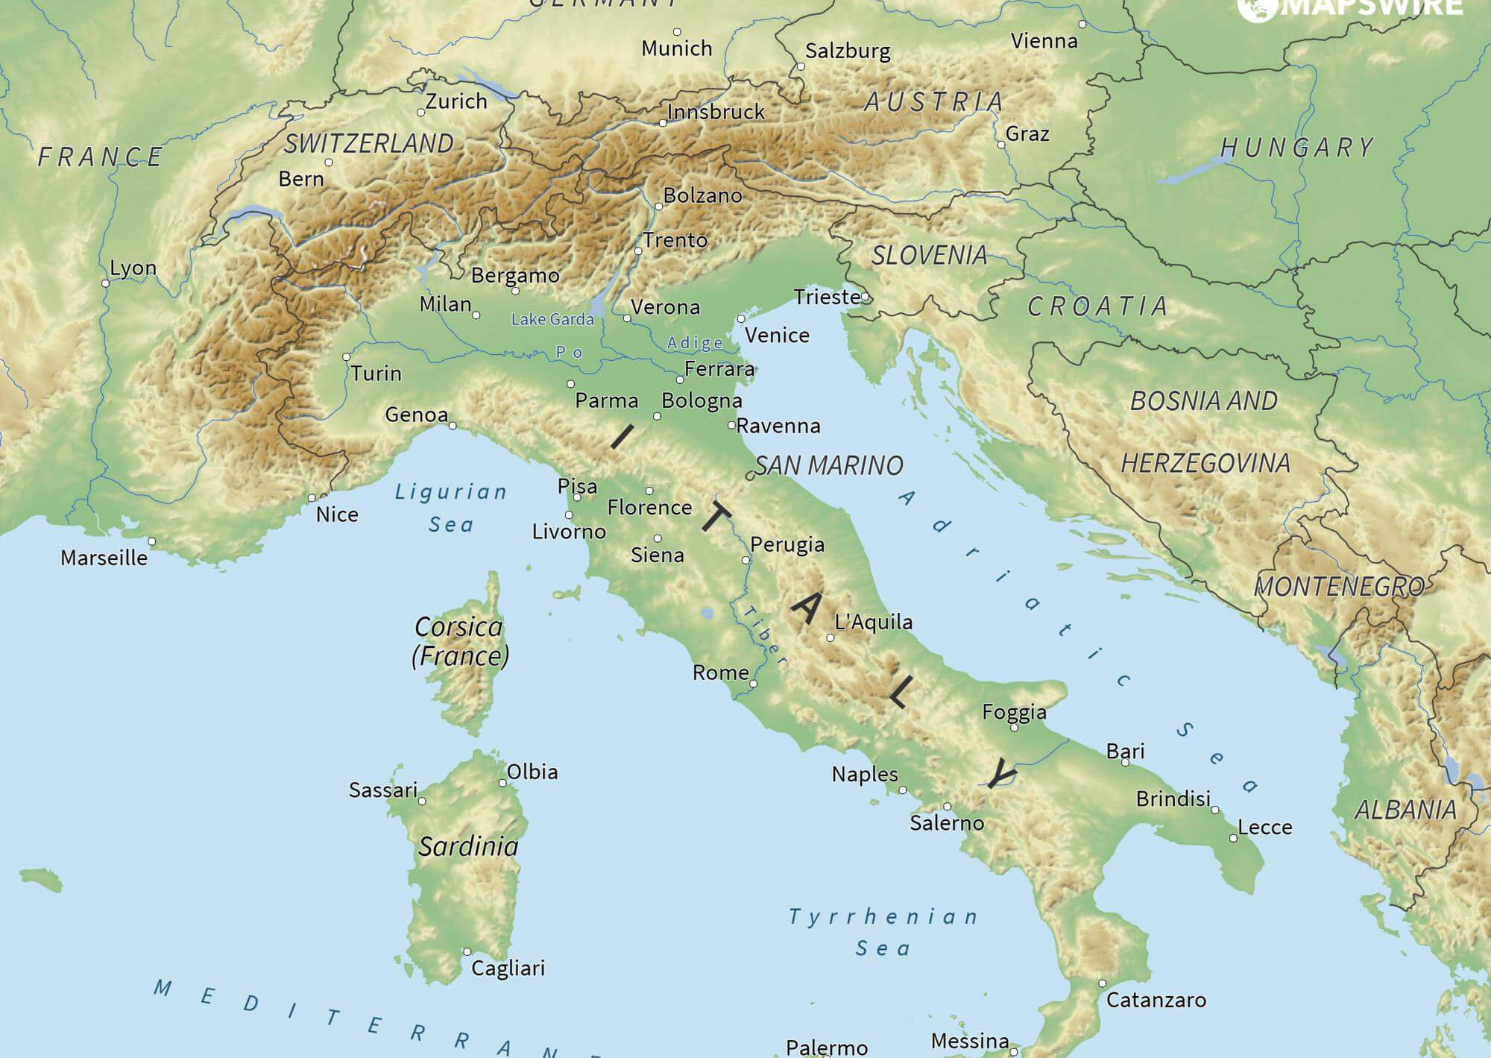
Basic information
Location: south of Europe
Capital: Rome
Climate: dry, hot
Population: 60 million
Language: native Italian-93%

Slide 4
History

Slide 5
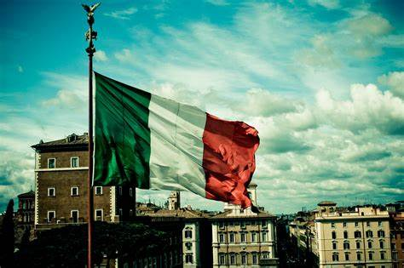
History/
-Ancient Roman Period-

Slide 6
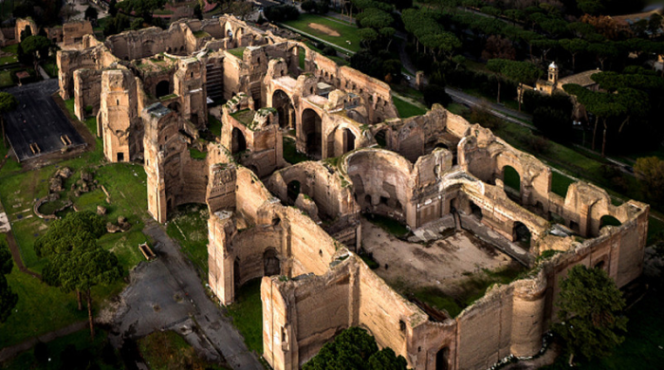
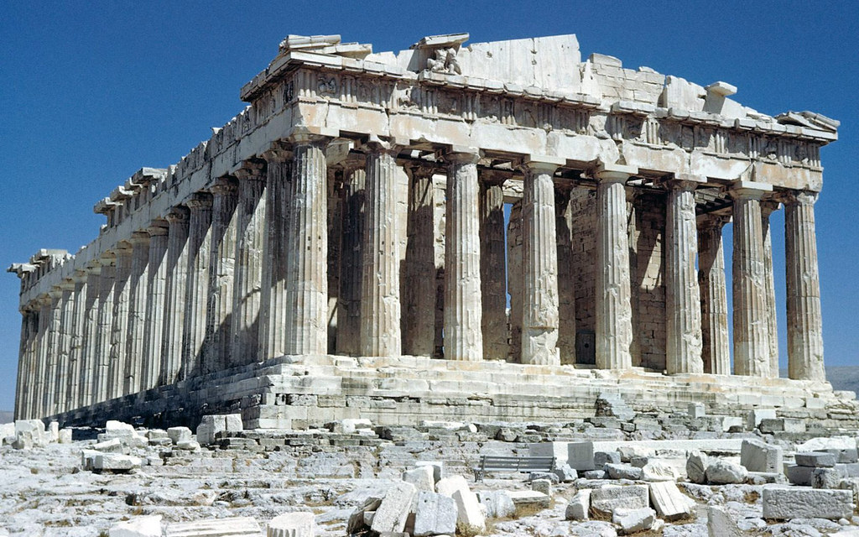
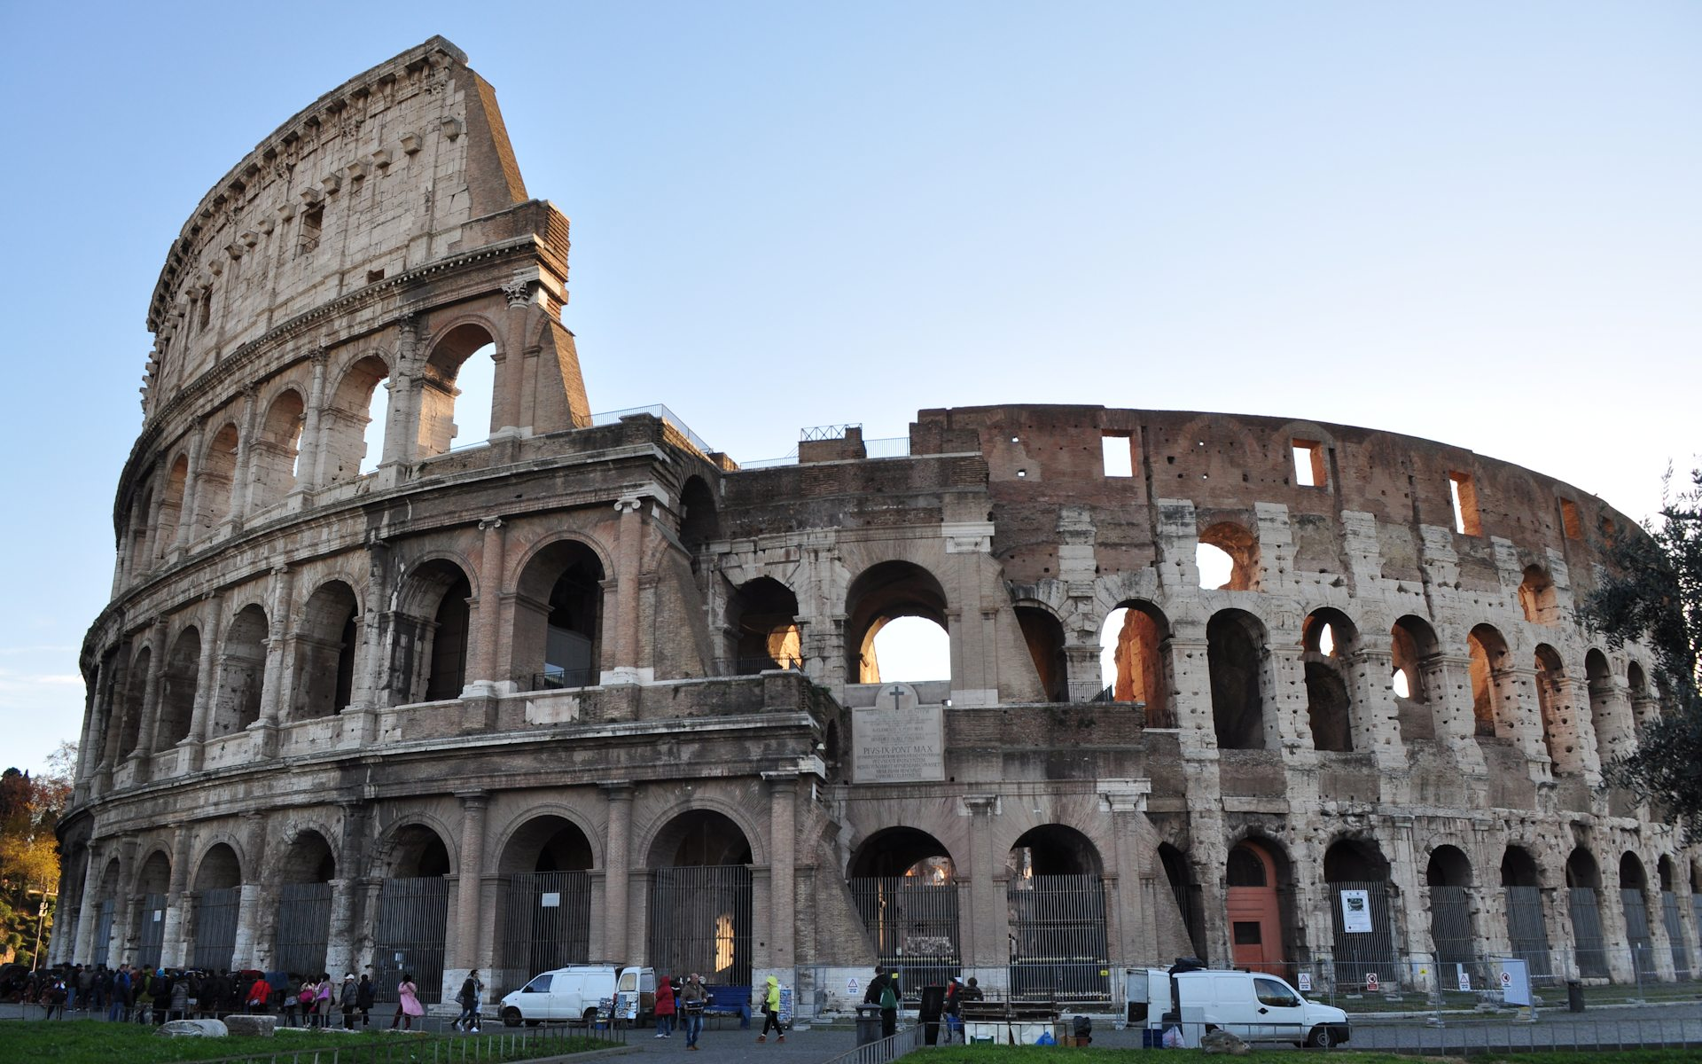
History/
-Ancient Roman Period-
Bath of Caracalla
Pantheon
Colosseum

Slide 7
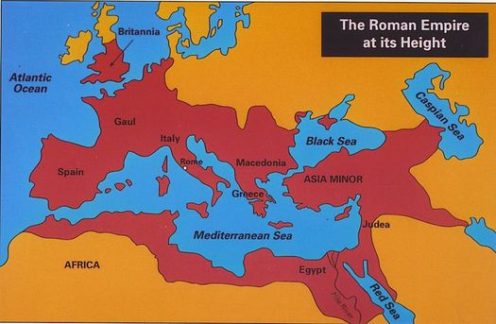
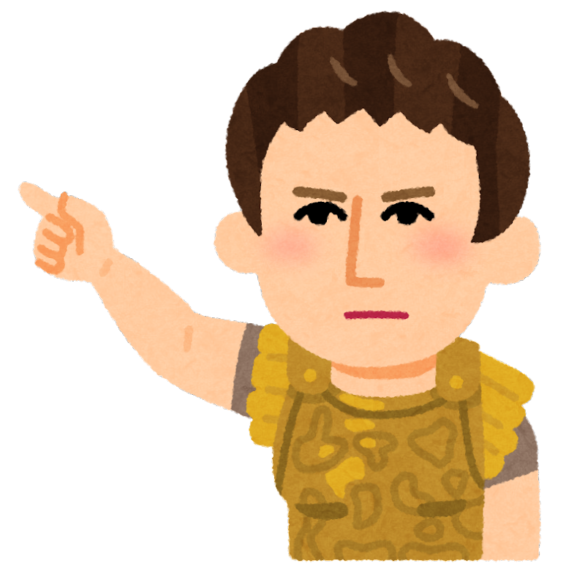
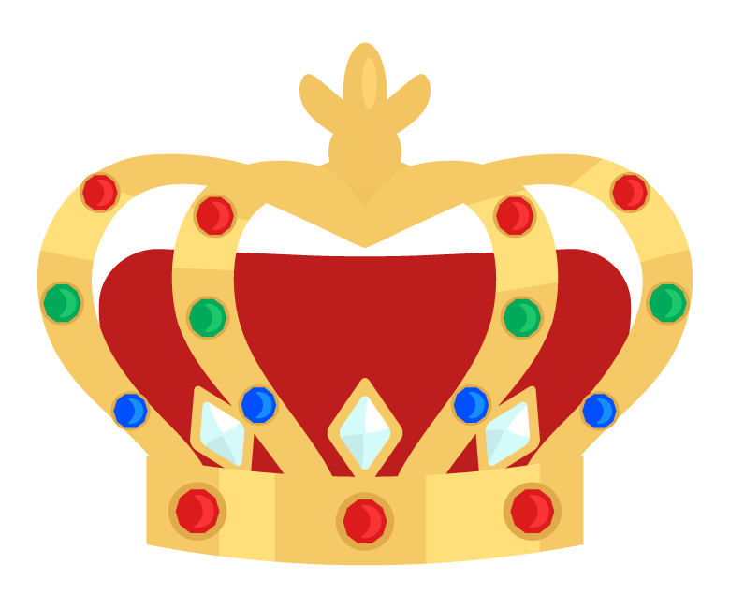
History/
-Ancient Roman Period-
Red area
Roman
Empire
Republic
Our territory!!

Slide 8

History/
-Ancient Roman Period-
Our techniques!!

Slide 9
Lifestyle

Slide 10
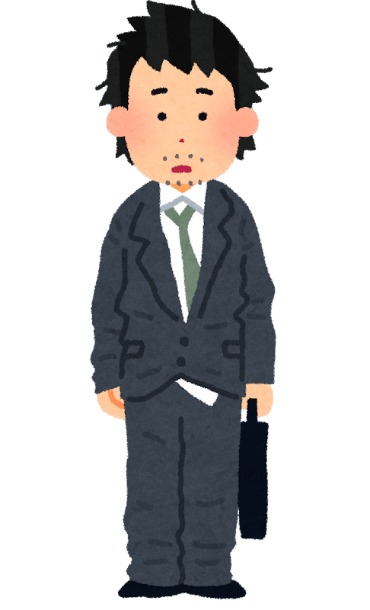
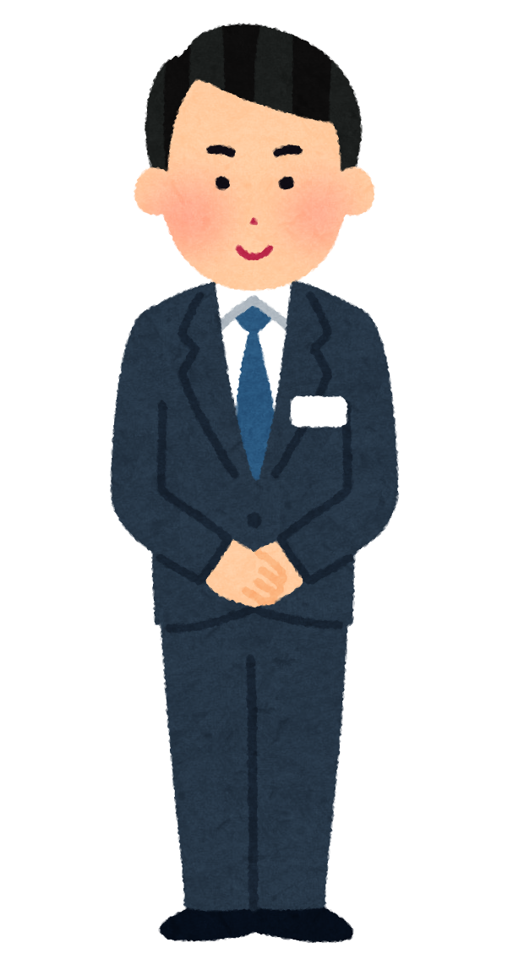
Lifestyle
Clothes-your status
How you dress is important!!!

Slide 11

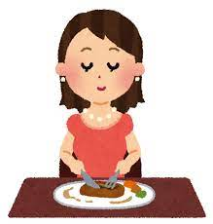
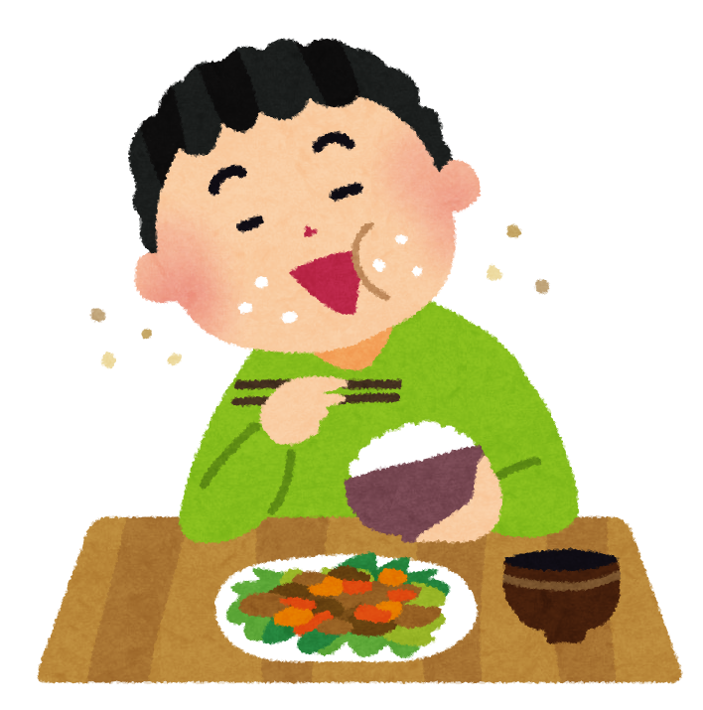
Lifestyle
Manners
Not on time
Table manners

Slide 12

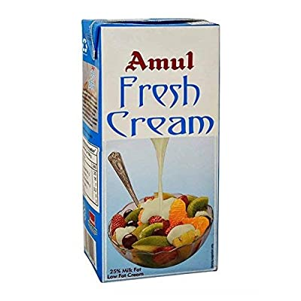
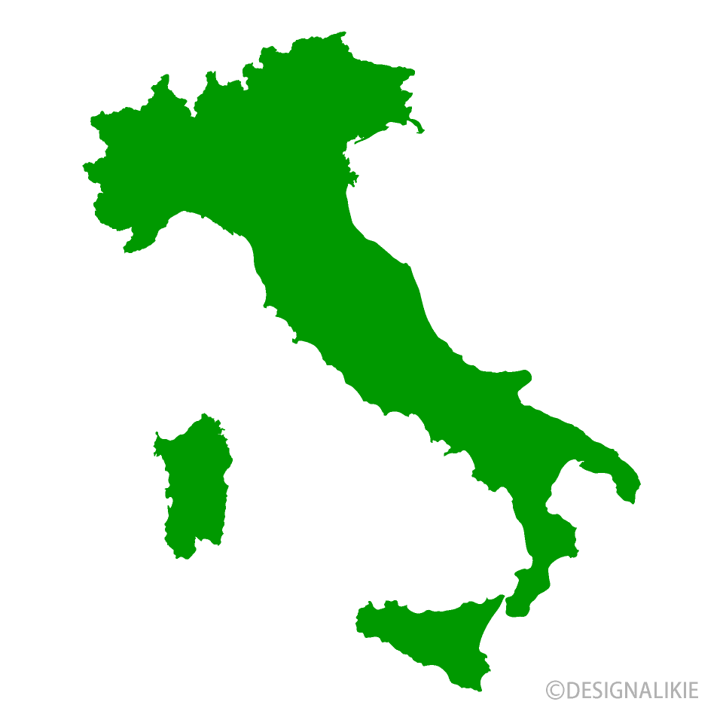
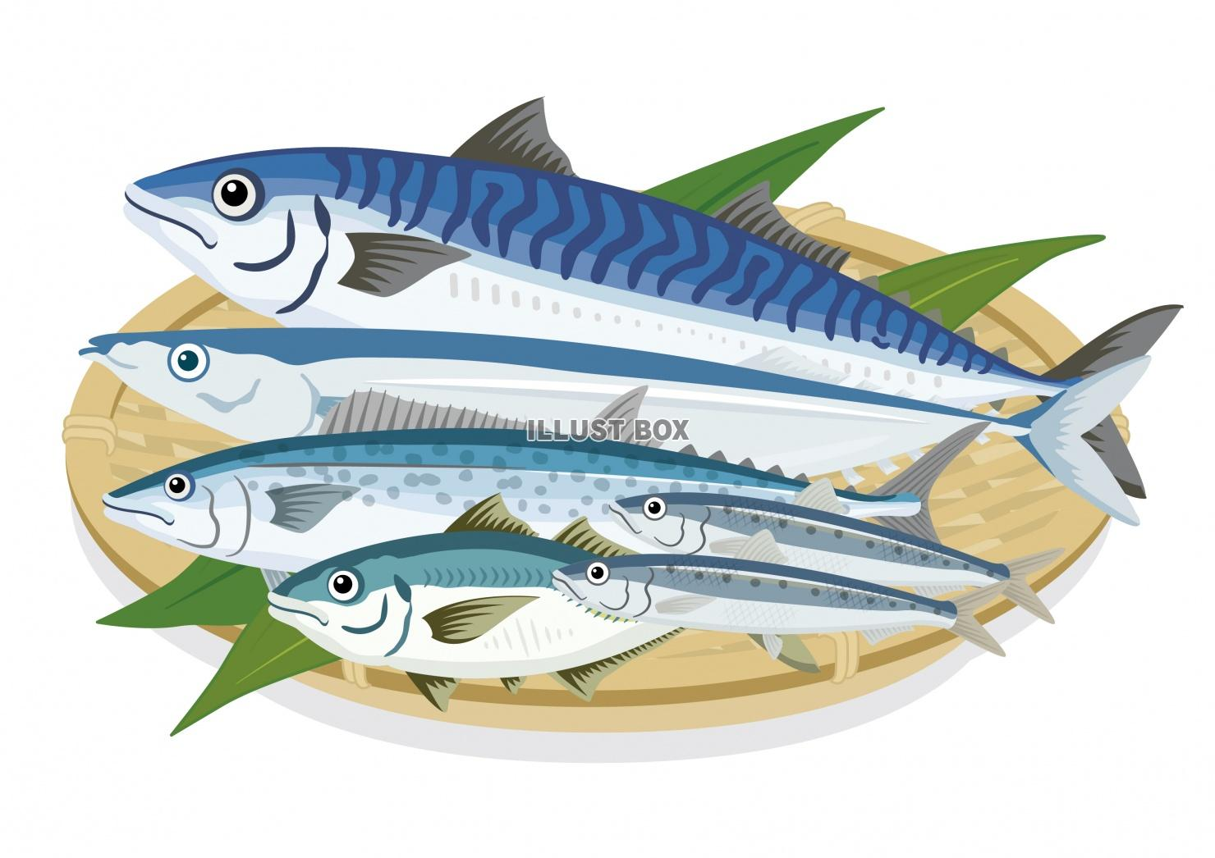
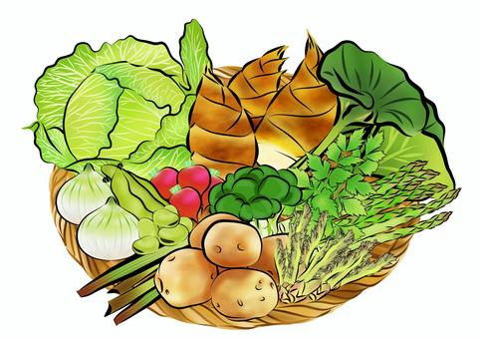
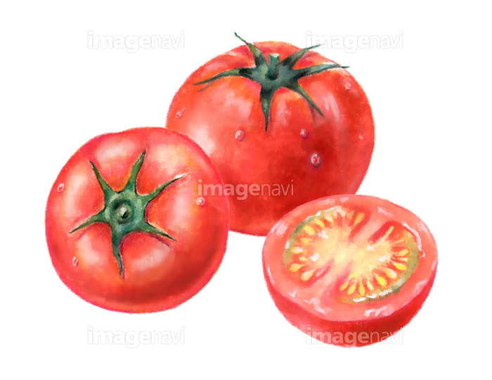
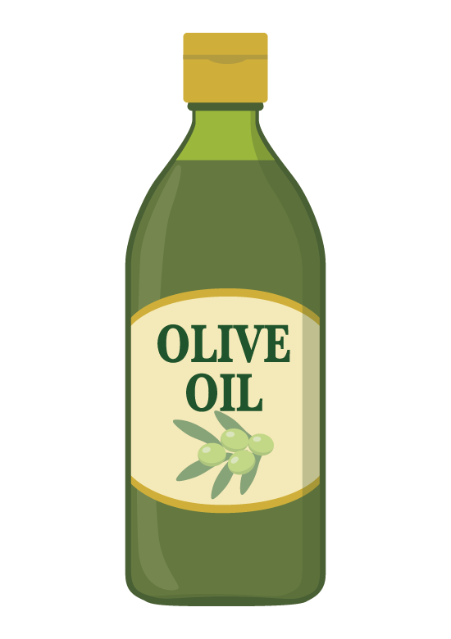
Lifestyle
Butter Fresh cream
Food of the mountain and ocean
Tomato Olive oil

Slide 13
Workstyle

Slide 14

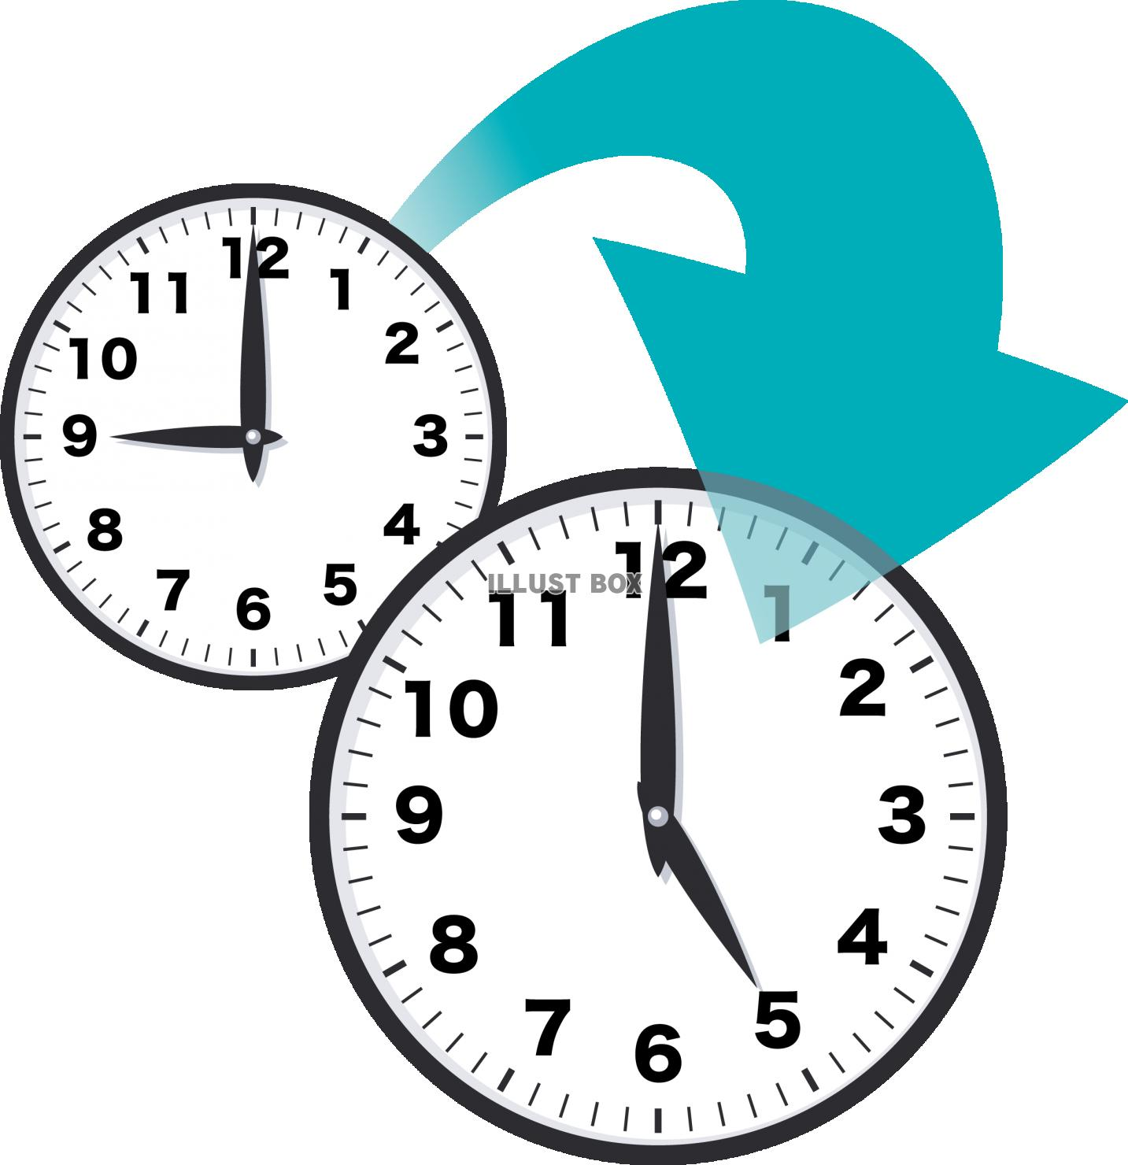
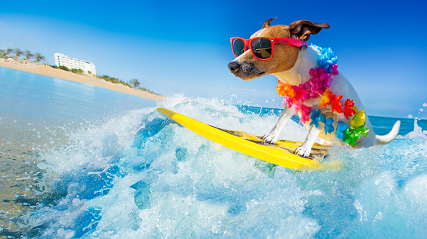
Workstyle/
Work Time
⇒8 hour in a day/ 40 hour in a week
⇒Same with Japan
Holiday
⇒many companis are closed in August

Slide 15

Workstyle/
▶Relationships
⇒Building relationships is important for the business

Slide 16
Workstyle/
▶Hierarchy
⇒respect powers and ages
Making decision⇒ By individuals

Slide 17
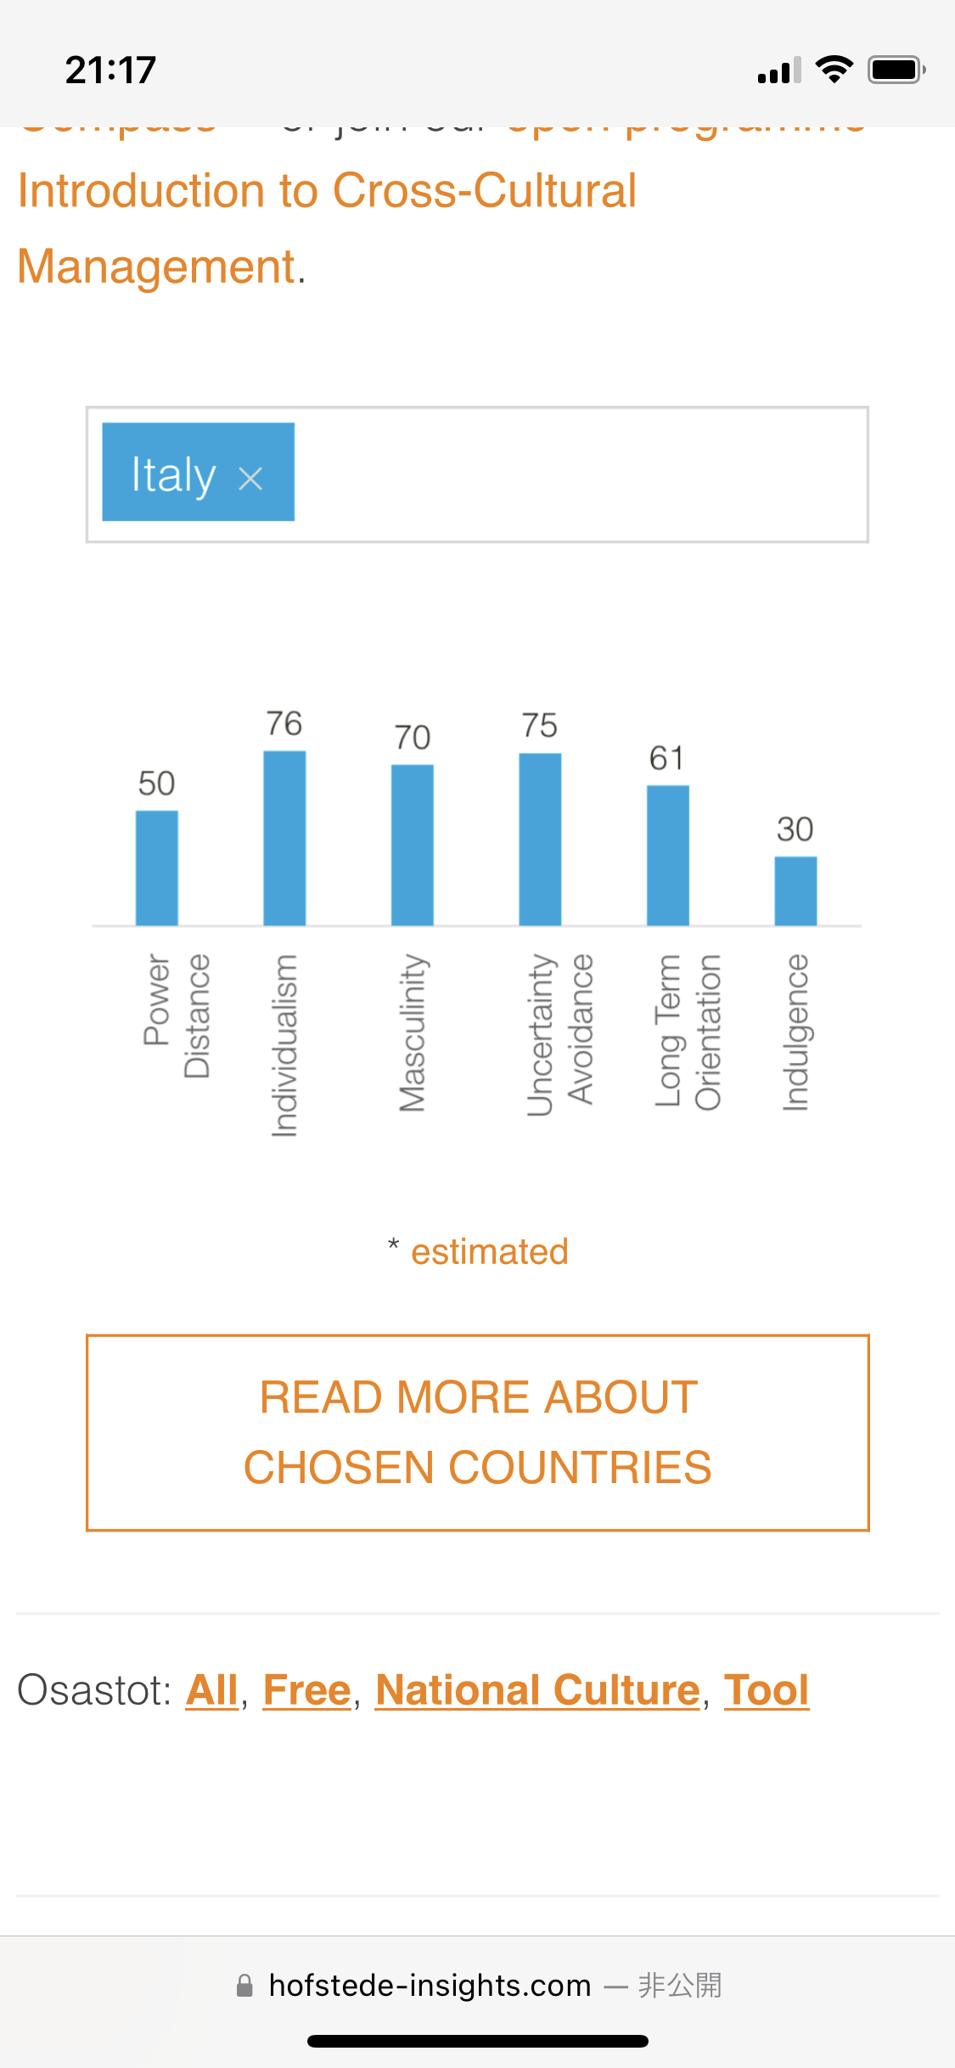
Workstyle/
▶Individualism

Slide 18

Workstyle/
50-50%
▶Power Distance

Slide 19
Education

Slide 20

Education/
▶Compulsory Education = 6-16 years old
Elementary School: 5 years
Junior High School: 3 years
High School: 5 years (2 years)

Slide 21
Politics and
Economy

Slide 22
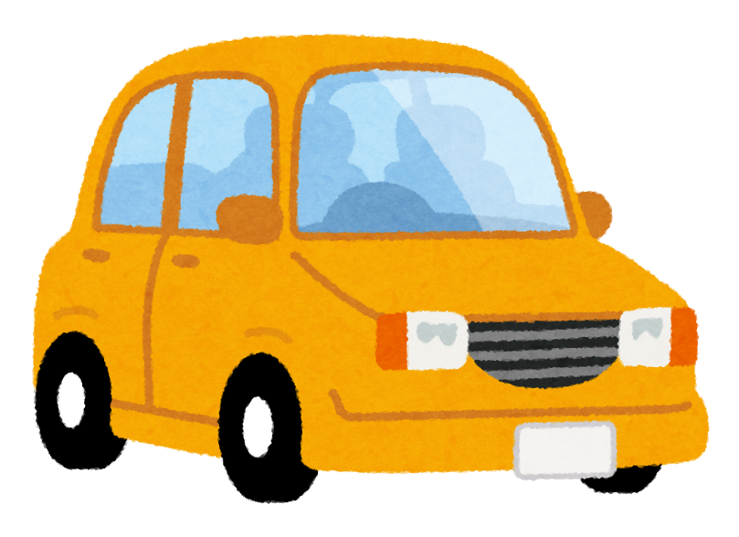
Politics
president
Prime minister
Environmental policy

Slide 23
Economy
Major industry
Consumption tax
Euro

Slide 24
Conclusion

Slide 25
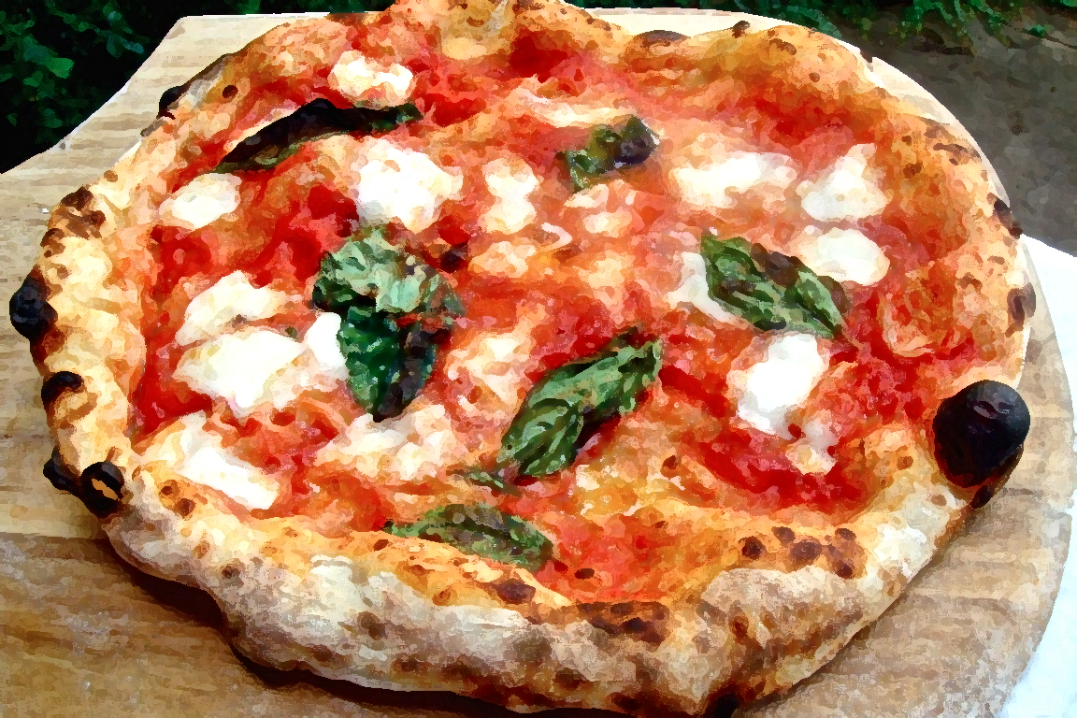
Grazie!!!

